Slide 1
Supervised Learning

Slide 2
Types of Learning
Supervised Learning (Today)
Learning from labeled training data: (input, correct output)
Unsupervised Learning (later this week)
Learning from unlabeled training data: (input, ?)
Semi-Supervised & Reinforcement Learning (Later Bootcamps)
Semi-Supervised Learning involves learning from a mix of labeled and unlabeled data.
Reinforcement Learning involves learning through reward maximization.

Slide 3
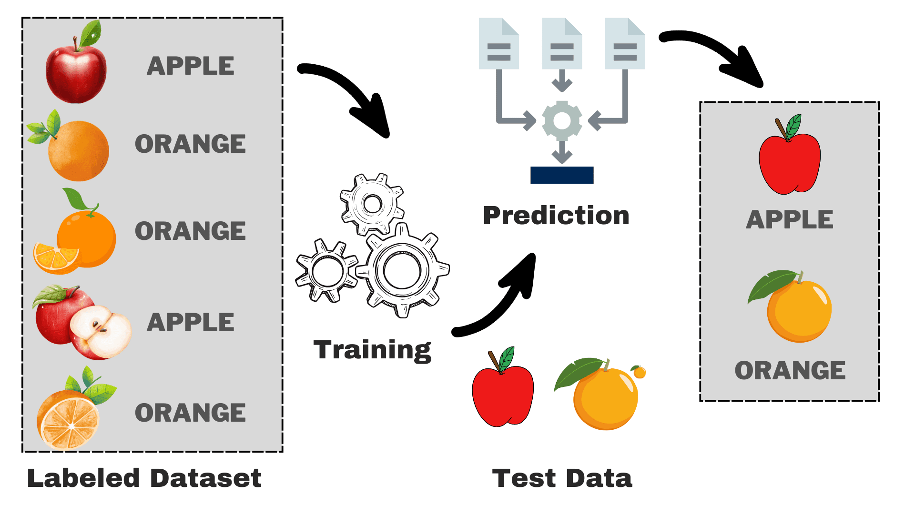
Supervised Learning
https://www.kdnuggets.com/understanding-supervised-learning-theory-and-overview

Slide 4
Supervised Learning
https://www.kdnuggets.com/understanding-supervised-learning-theory-and-overview

Slide 5
Supervised Learning
https://www.kdnuggets.com/understanding-supervised-learning-theory-and-overview

Slide 6
Supervised Learning
https://www.kdnuggets.com/understanding-supervised-learning-theory-and-overview

Slide 7
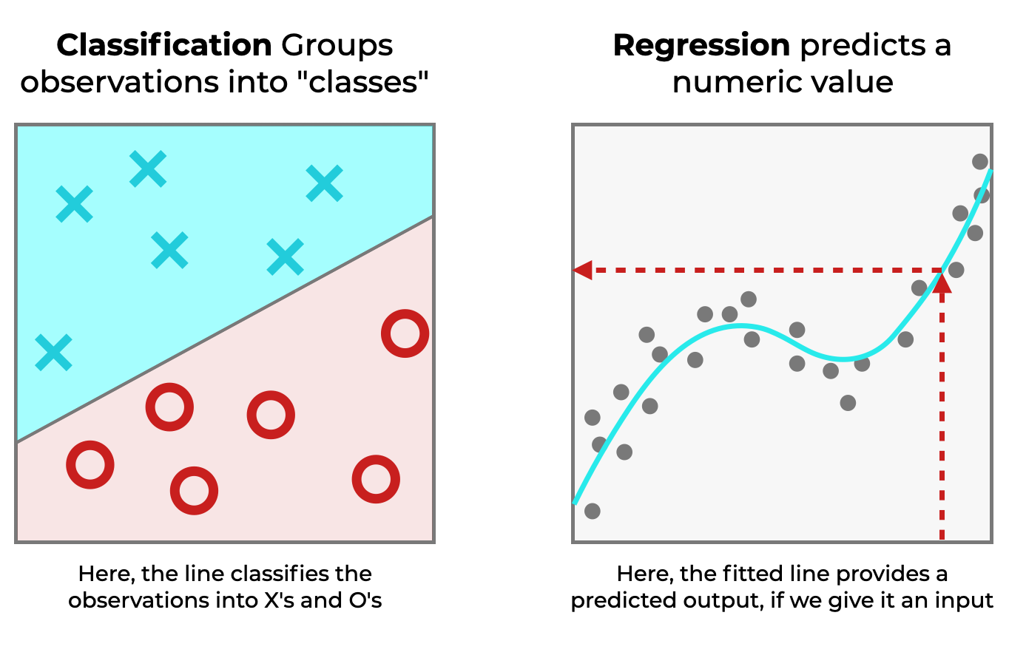
Basic Types of Supervised Learning
Regression
Predicting continuous numerical values based on input feature
Classification
Predicting a discrete class label based on input feature
https://www.sharpsightlabs.com/blog/regression-vs-classification/

Slide 8
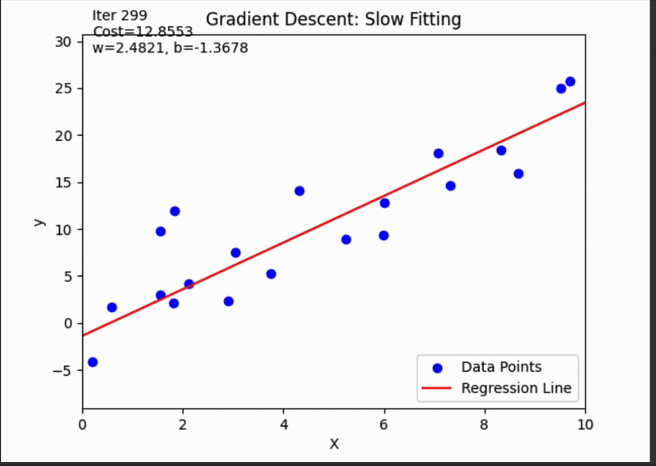
Regression
Given data in the form: [(X₁, Y₁),...,(X_{N}, Y_{N})] where each (X_{i}, Y_{i}) corresponds to input X_{i} and a real valued (continuous) output Y_{i}.
The regression model learns a real valued function: ŷ = f(X) ⋹ IR
To predict new output values simply plug in x into the function.

Slide 9
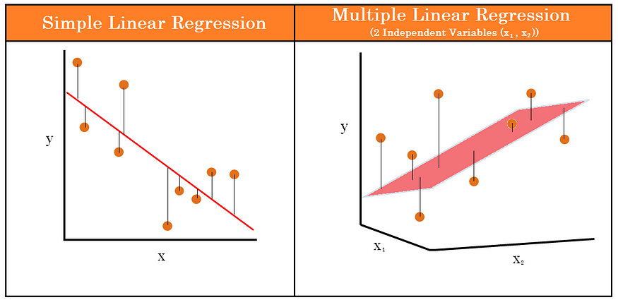
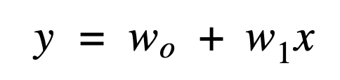
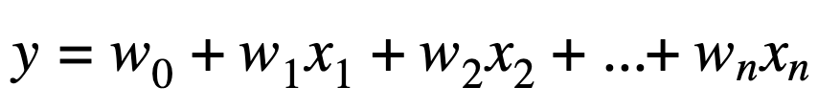
Goal of Linear Regression
Find the values for the unknown parameters (w) known as weights that minimize the average distance between all inputs and the real valued linear function (ŷ).
𠆢
𠆢

Slide 10
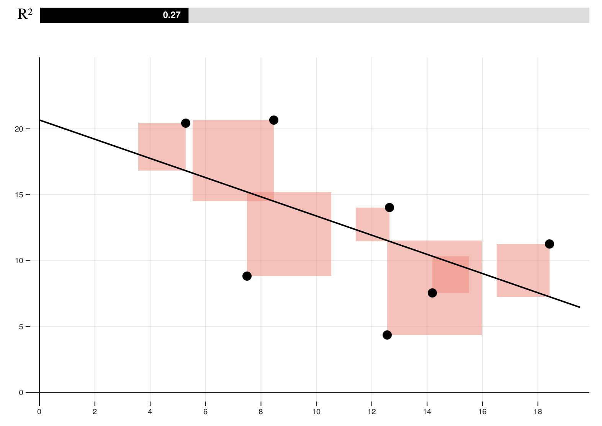
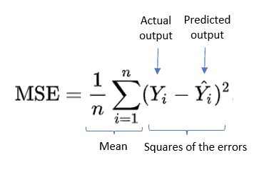
Linear Regression Weights
For linear regression models, the weights are calculated by minimizing Mean Squared Error (MSE) which is the squared distance between each point and the line of best fit.
𠆢
Notes:
Engagement questions:
what other error measures can you think of that we can use here?
What are the advantages of MSE?

Slide 11
Advantages of Mean Squared Error
Differentiable everywhere
Closed form solution for linear models
Penalizes large errors
Nice analytical properties
Solution to maximum likelihood

Slide 12
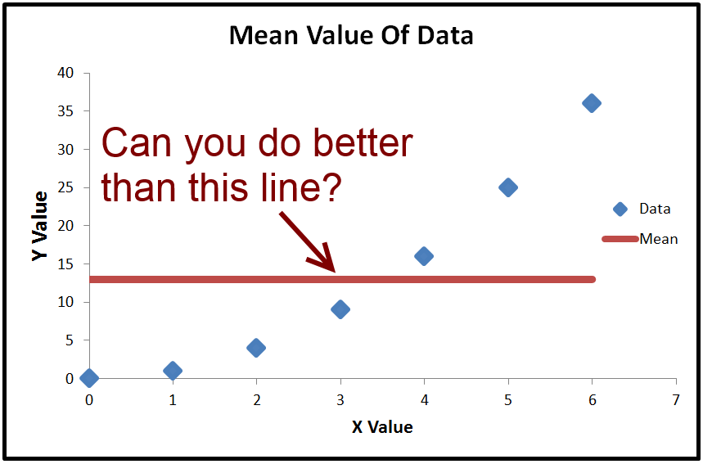
Linear Regression
How would you change the mean to reduce MSE and increase the accuracy of our model?
𠆢

Slide 13
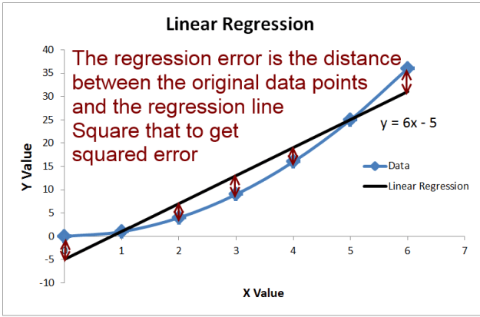
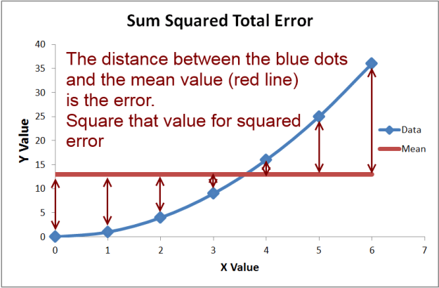
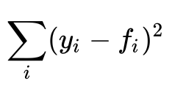
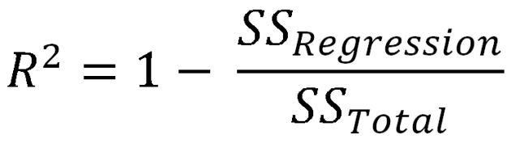
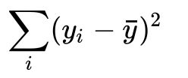
Linear Regression
Weights are evaluated using Coefficient of Determination(R²) which shows how much of the variability in the data is explained by the independent variable.
Mean Squared Error
Proportional to variance in our data.
Notes:
How well does our line fit the data compared to simply taking the average.

Slide 14
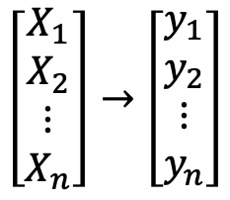
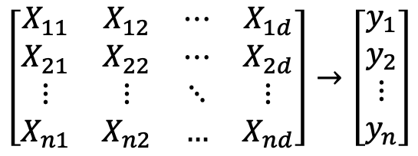
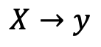
Linear Regression: Minimizing Mean Squared Error

Slide 15
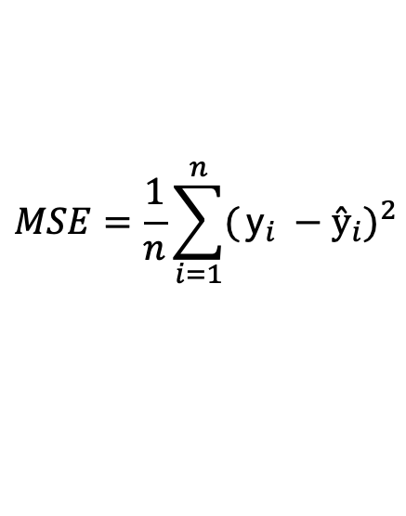
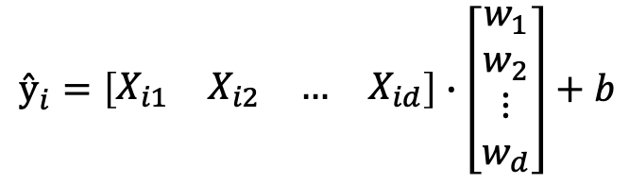
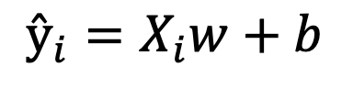
Linear Regression: Minimizing Mean Squared Error
Bias
Input
Weights

Slide 16
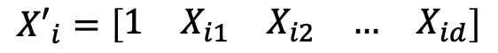
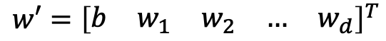
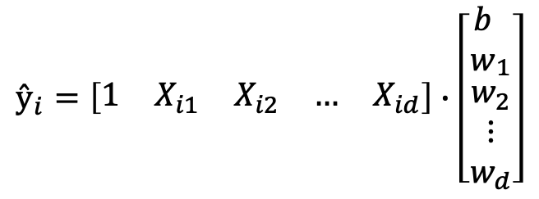
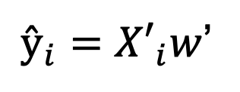
Linear Regression: Minimizing Mean Squared Error

Slide 17
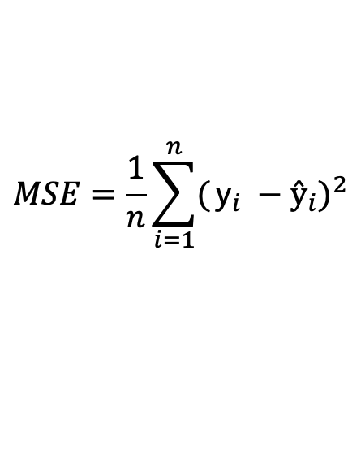
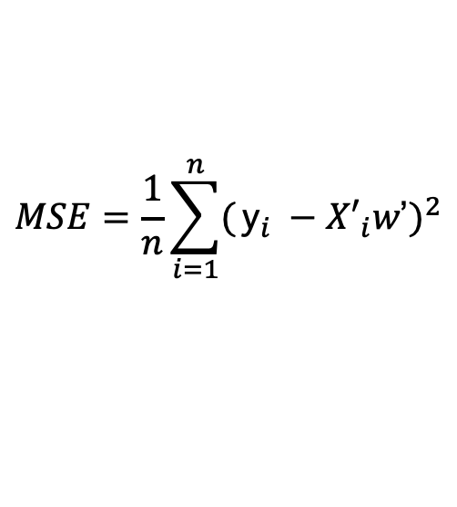
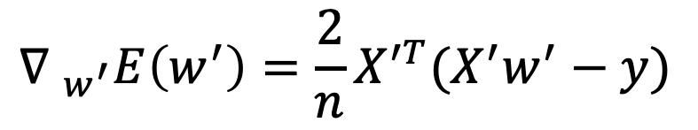
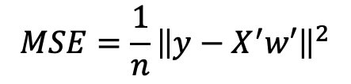
Linear Regression: Minimizing Mean Squared Error

Slide 18
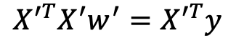
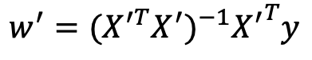
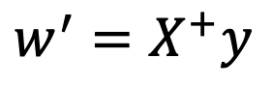
Linear Regression: Minimizing Mean Squared Error
The process of finding weights that minimize MSE error a linear regression model is known as Ordinary Least Squares (OLS).
We multiply these weights by any new input to predict its value.

Slide 19
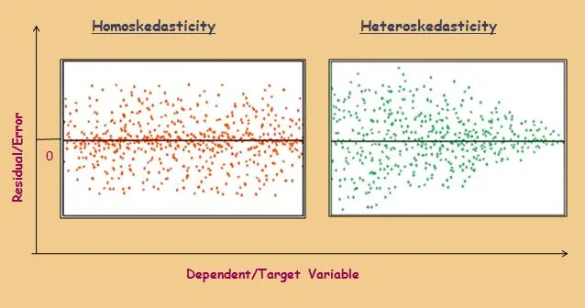
Homoskedasticity and Heteroskedasticity
Homoskedasticity is achieved when variance is constant across all observations, and does not depend on the value of the explanatory variables.
If Homoscedasticity holds, then the OLS weights for a linear regression model are the Best Linear Unbiased Estimator.
Notes:
If Homoscedasticity holds, then the Gauss-Markov Theorem states that the Ordinary Least Squares weights for a linear regression model are the Best Linear Unbiased Estimator meaning that these weights have the smallest variance among all unbiased and linear weights. Here, unbiased means that on average IE[f(x)] is equal to the true value of x hence not biased towards any input.

Slide 20
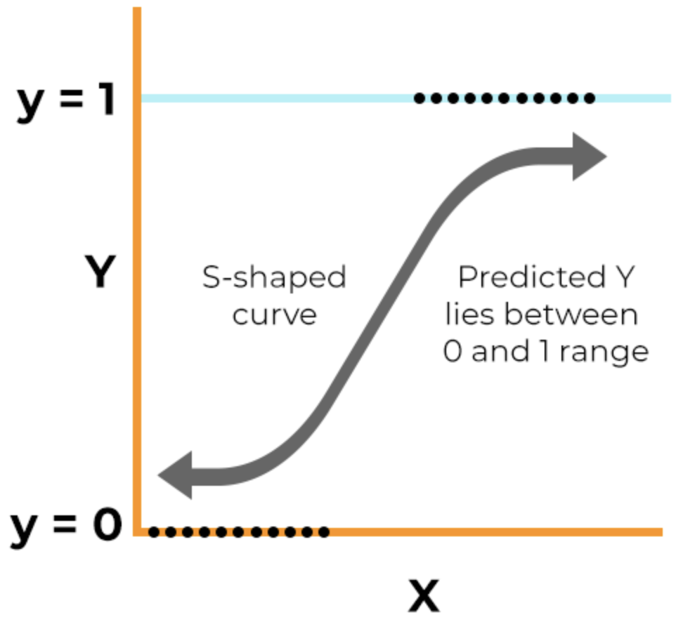
Logistic Regression
This supervised learning learning model predicts the continuous likelihood of an outcome class given some input.
Commonly used for binary classification.
Why is it called a regression model?
Can you think of a scenario where it is not used for classification?

Slide 21
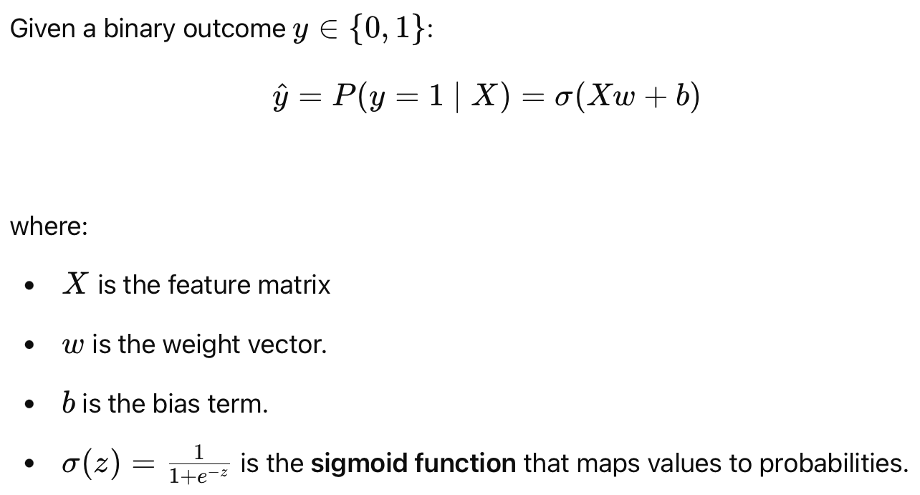

Logistic Regression With Binary Outcomes
https://www.saedsayad.com/logistic_regression.htm

Slide 22
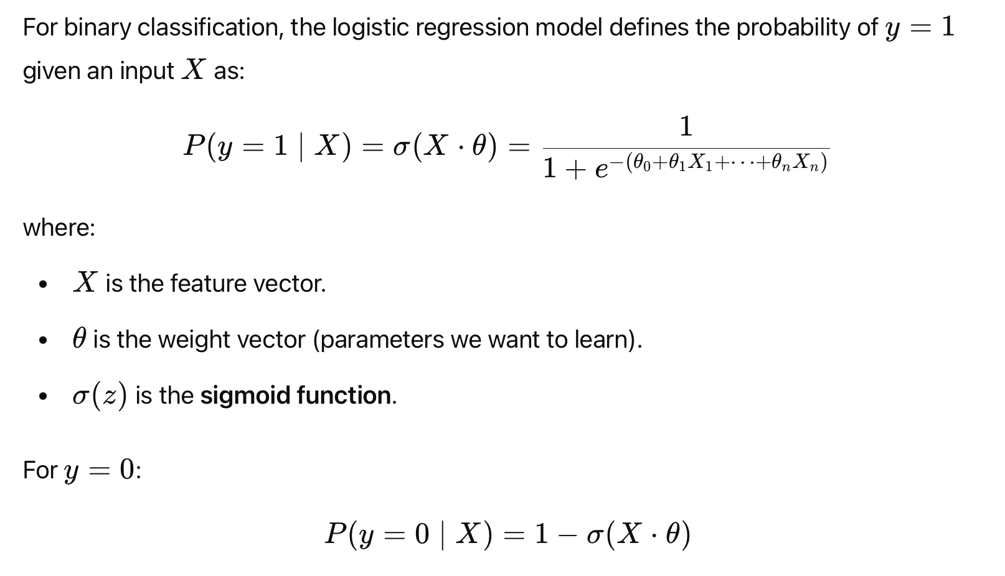
Logistic Regression Weight Calculation
Sigmoid
Function
Label
Input
Features

Slide 23
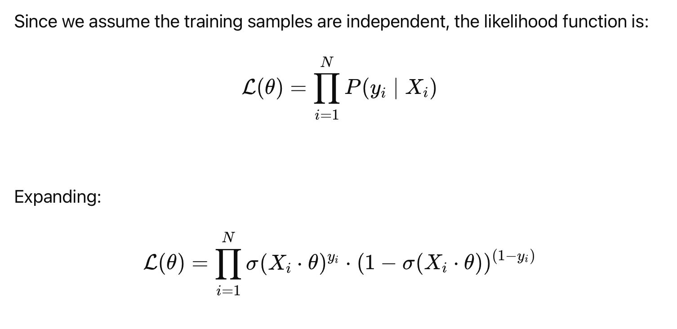
Logistic Regression Weight Calculation

Slide 24
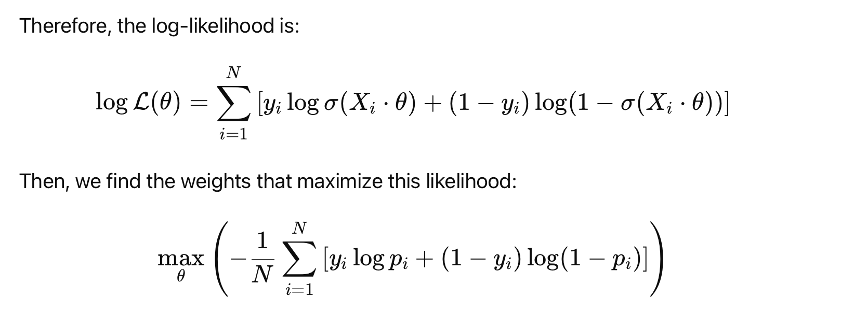
Logistic Regression Weight Calculation

Slide 25
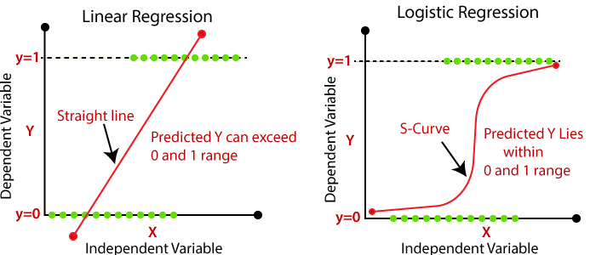
Logistic Regression vs Linear Regression
Logistic regression maps inputs to the likelihood that it belongs to a certain class.
We use a sigmoid curve to get a range of probabilities instead of just zero or one classification.
In logistic regression we find the weights by maximizing the log likelihood.

Slide 26
Logistic Regression Pros and Cons
Pros:
Simple and Interpretable
Probabilistic Output
Computationally Efficient
Binary Classification
Cons:
Assumes linearity (with the log-odds of dependent variable)
Sensitive to outliers
Requires independence of features

Slide 27
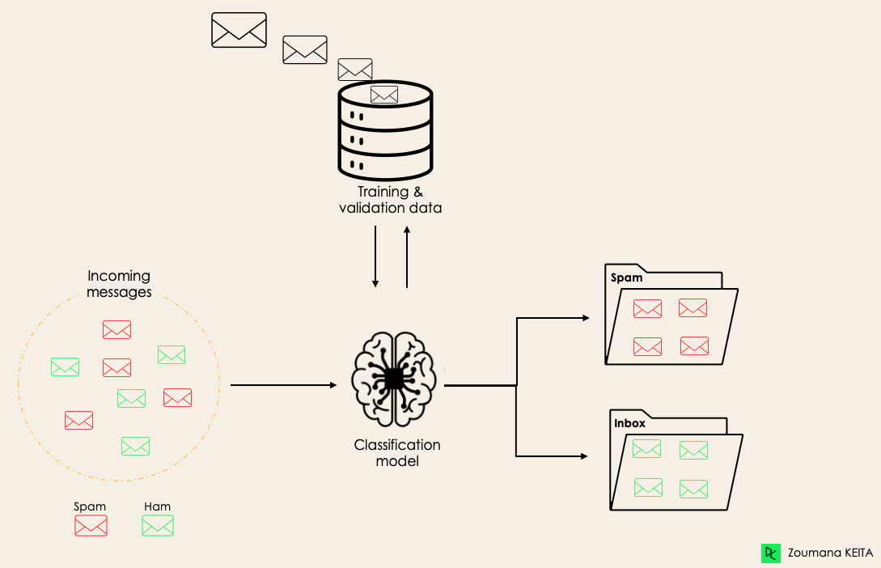
Classification
Given data in the form: [(X₁, Y₁),...,(X_{N}, Y_{N})] where each (X_{i}, Y_{i}) corresponds to an input X_{i} and a categorical (discrete) output Y_{i}.
The regression model learns a mapping function: f: X → Y
Here Y is a category is our set of categories.

Slide 28
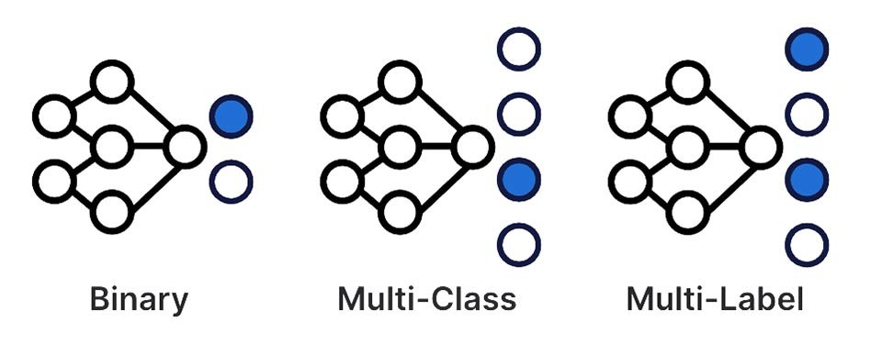
Types of Classification
Binary: We have two categories and classify each input into one of the two categories.
Multiclass: We have more than two categories however, we classify each input into only one of the categories.
Multi-Label: We have more than two categories, and each input can belong to multiple categories.

Slide 29
Examples
We want to design models that achieve the following goals. Which classification model should we use:
Given an email, we want to determine whether it is spam or not.
Given a song, determine which category of music it belongs to.
Given an image determine which animal it is.

Slide 30
Examples
We want to design models that achieve the following goals. Which classification model should we use:
Given an email, we want to determine whether it is spam or not.
Given a song, determine which category of music it belongs to.
Given an image determine which animal it is.

Slide 31
Examples
We want to design models that achieve the following goals. Which classification model should we use:
Given an email, we want to determine whether it is spam or not.
Given a song, determine which category of music it belongs to.
Given an image determine which animal it is.

Slide 32
Logistic Regression For Classification Pipeline

Slide 33
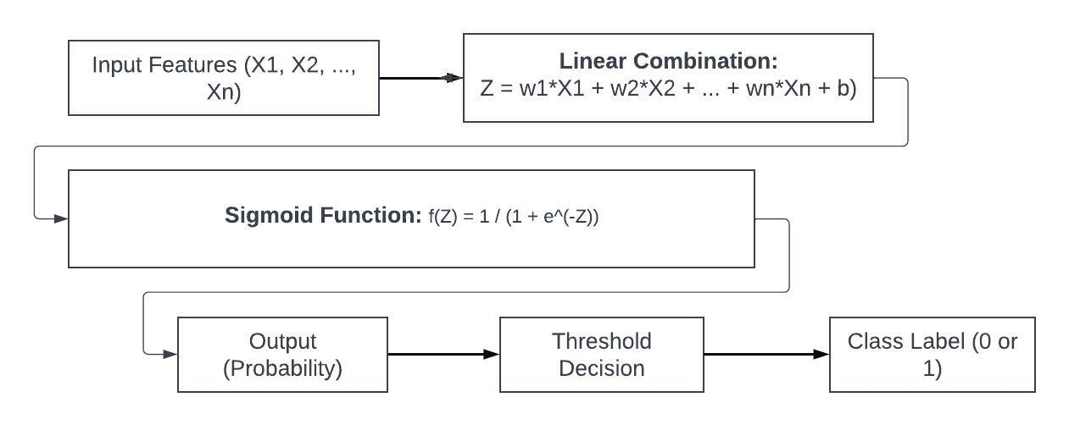
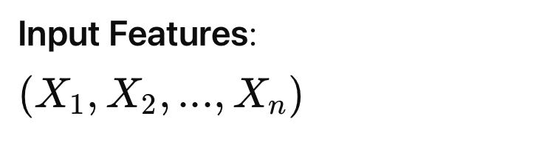
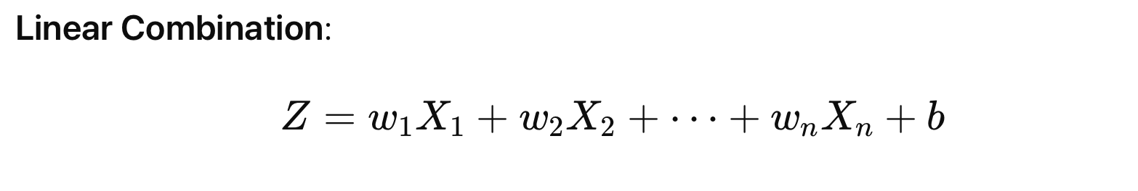
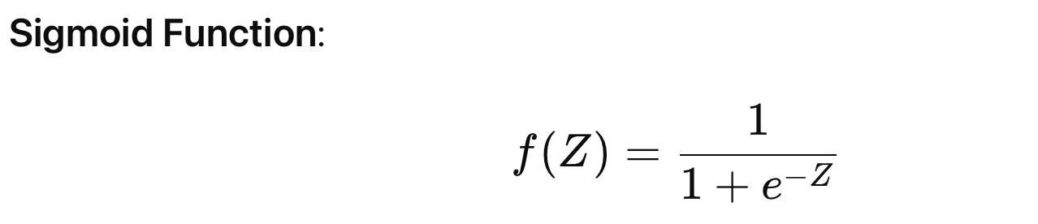

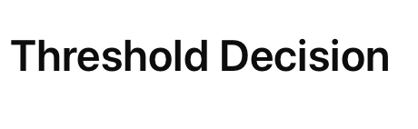
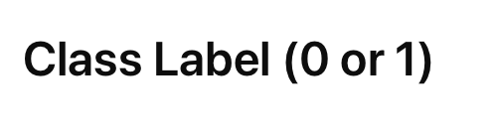

Slide 34
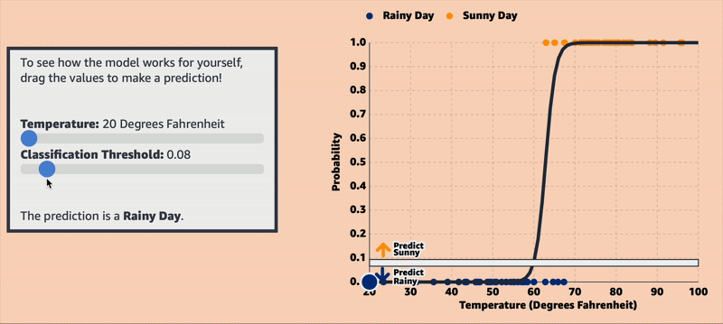
Logistic Regression for Classification Example

Slide 35
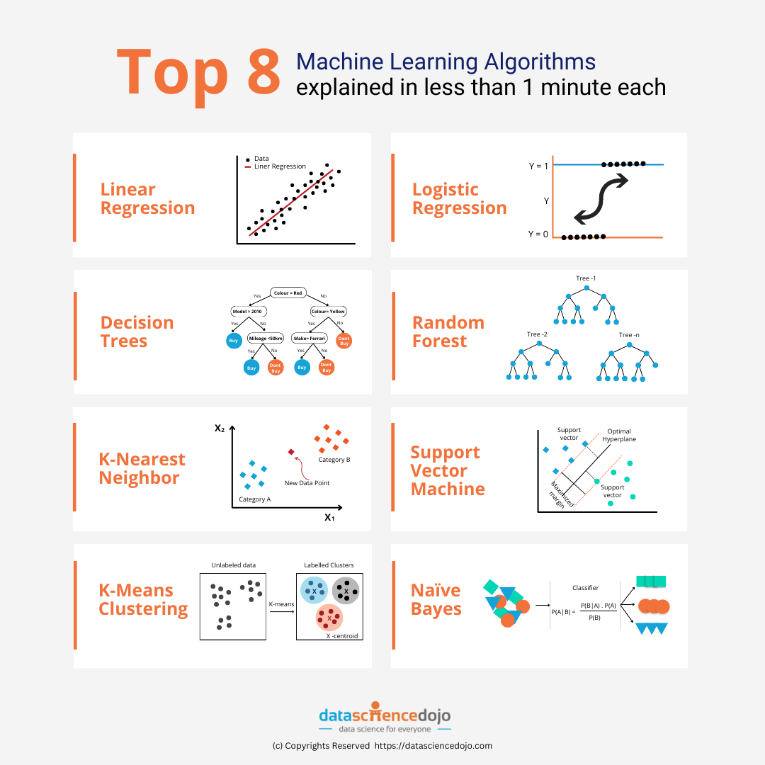
Popular Classification Algorithms
K-Nearest Neighbors (KNN): Given a new input classify the same as the majority class of it’s K closest neighbors.
Decision Tree (DT): Recursively splits data into decision-based branches
Support Vector Machine (SVM): Finds the optimal hyperplane to separate classes in high-dimensional space classifying new inputs into one class.

Slide 36
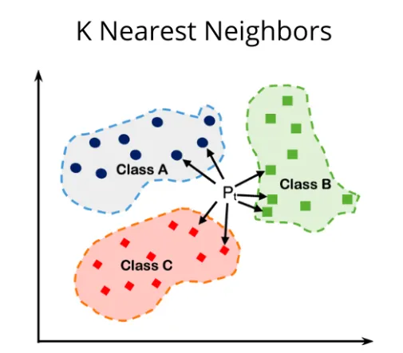
Classification Algorithms: KNN
Algorithm:
Define K (number of neighbors)
For each new data point X:
Compute the euclidean distance between X and all training points
Classify X with label of the most frequent class among its K nearest neighbors
source

Slide 37
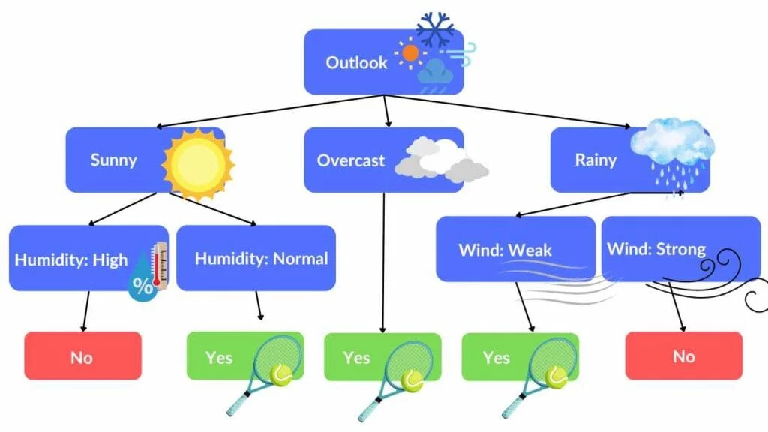
Classification Algorithms: DT
Algorithm:
Select the best feature to split on and split the dataset based on it.
Recursively repeat the above for each subset until some stopping condition. The leaf node should be the category for
For each new input, traverse the tree based on feature values until a leaf node classification.
X: {Outlook, Temperature, Humidity, Wind}
Y: {Play tennis, Don’t play tennis}
https://spotintelligence.com/2024/05/22/decision-trees-in-ml/#What_are_Decision_Trees

Slide 38
Framing a Learning Problem

Slide 39
Designing a Learning System
Define the ideal outcome and the model's goal
Choose how to represent the target function
Determine the appropriate learning algorithm to infer the target function based on research.
Define success metrics and test.
Learner
Training Data
Environment / Experience
Knowledge
Testing Data
Evaluation
Based on slide by Ray Mooney

Slide 40
Housing Price Predictor
Goal: We want to design a model that will examine the components of a house to determine its price.
What does our input look like?
What does our output look like?
What would our our target function look like?
What kind of model is needed for this task?
https://colab.research.google.com/drive/1yQ2_Aau5Ml75NklC_8MKwMzOEnezRsu-#scrollTo=llullIZYtZi7&uniqifier=1
Based on slide by Ray Mooney

Slide 41

Housing Price Predictor
What does our input look like?
X: {House Features}
What does our output look like?
Y: Housing price (Real Value)
What would our our target function look like?
f({House Features}) → Price
What kind of model is needed for this task?
Regression Model
What are some success metrics we could use?
Based on slide by Ray Mooney

Slide 42
Housing Price Predictor
Success Metric: R²
Learner
Training Data
Housing Prices
(X house features, Y price)
Knowledge
Testing Data
Evaluation
Seeing it in Action
Based on slide by Ray Mooney

Slide 43
Splitting Dataset
Dataset is typically split into a train and test set
Training set is used to train the model
Test set is used to evaluate the model based on various metrics
The typical split is: 80% training, 20% testing.
We assume that each data sample was is independently drawn from the same overall distribution of data making all data points Independent and Identically Distributed (iid)

Slide 44

Overall Machine Learning Pipeline
Data extraction & analysis
Data preprocessing
Model Training
Model Evaluation & Validation

Slide 45

https://reproducible.cs.princeton.edu/

